Slide 1
Sorting service
Requirements
Functional
Client should be able to enqueue a massive of numbers to be sorted
Sorting should be processed in background
Client shoudl be able to query status/results of processing
Nonfunctional
Security, only users with privileges can use the service
Reliability, in case of interruptions/exceptions service should restart or continue processing
Performance, it should be possible to mitigate performance issues with scalability
Maintainability,
service should be easily extended with additional functionality/new type of processing
Easy support of potential changes in SLA (Service Level Agreements) for resiliency and availability
Scalability, support of horizontal/vertical scalability

Slide 2
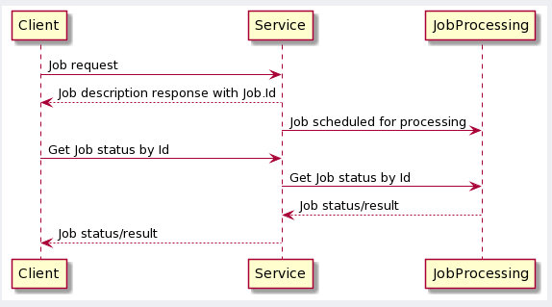
Architectural decisions Setting problem context:
Diagram showing Functional requirements
This service will process rather big amount of data and/or processing logic might be rather complex what might require significant time to process data.
Background processing of data with possibility to track results should mitigate the problem

Slide 3
Architectural decisions Setting problems to solve:
Architectural diagram
Link to Drive.Io diagram
- !!!Describe how architecture fulfill requirements
- !!!Describe and justification of technologies chosen (Kafka/Redis/containers)
- !!! Milestones/RoadMap for implementation of MVP and further improovements

Slide 4
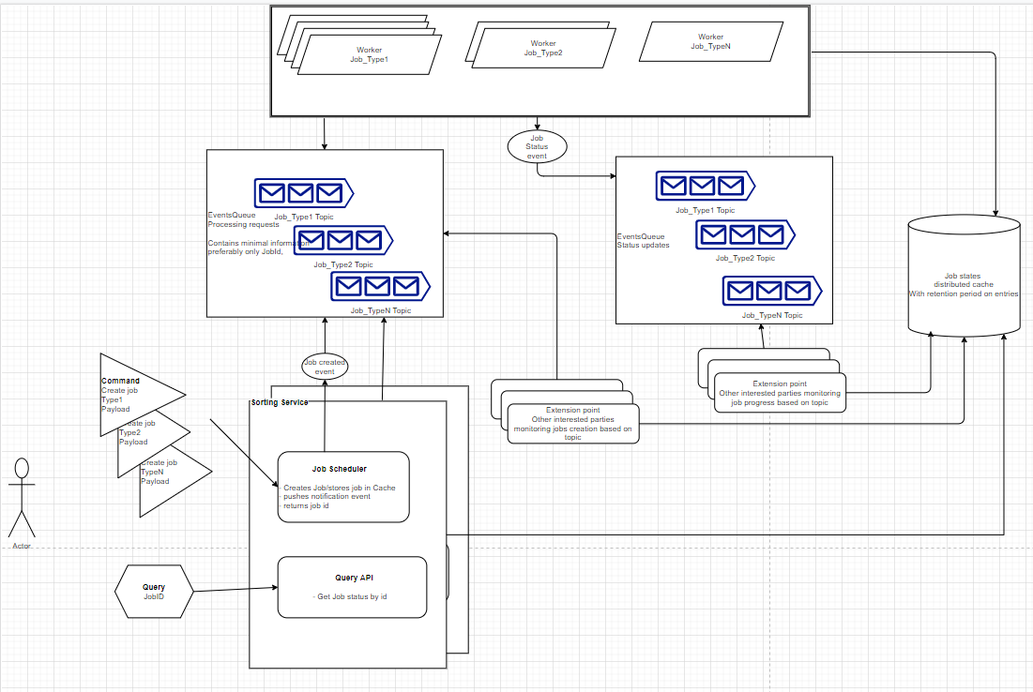

Slide 5
RoadMap
Milestone 0
POC (working solution ready for preliminary performance/resiliency testing
Demo
Milestone 1 (MVP version)
production reediness
Team onboarding, Addressing Technical debts, Tests coverage, App Monitoring, CI/CD
Release procedures
Documentation, Chaos testing, Load testing, Dashboards, Alerts definitions, Services runbooks
Milestone2 (Stabilisation)
Fixing bugs, optimizations/improvements, collecting feedback
Milestone3 (Performance improvements )
Performance testing/tuning/improvements
Operational costs optimizations

